Slide 1

Cognito
HackTricks Training
https://t.me/CyberFreeCourses

Slide 2
Basic Information - Cognito
Cognito provides authentication, authorization and user management for your web and mobile apps. Your users can sign in directly with a username and password, or through a third party such as Facebook, Amazon, Google or Apple.
The two main components of Amazon Cognito are user pools and identity pools.
User pools are user directories that provide sign-up and sign-in options for your app users.
Identity pools enable you to grant your users access to other AWS services.
https://t.me/CyberFreeCourses
https://cloud.hacktricks.xyz/pentesting-cloud/aws-pentesting/aws-services/aws-cognito-enum

Slide 3
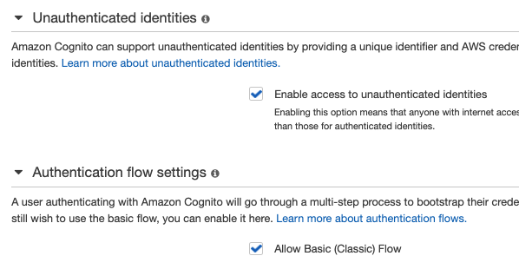
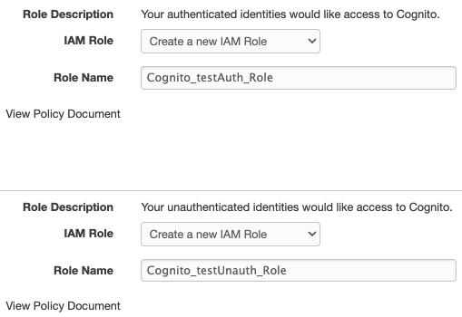
Basic Information - Identity Pools
2 different flow un-authentications:
Enhanced flow (default): When session credentials are generated, a restrictive session policy is attached to the session only allowing to access services from this list.
Basic flow: This authentication requires an extra step, but the session won’t be restricted by any session policy.
https://t.me/CyberFreeCourses
https://cloud.hacktricks.xyz/pentesting-cloud/aws-pentesting/aws-services/aws-cognito-enum/cognito-identity-pools

Slide 4
Basic Information - Identity Pools
Authenticated flow:
When a user is authenticated in the User Pool with an Identity Provider he could try to access the role granted to authenticated users.
This flow doesn’t attach any session policy to the session.
If different platforms are allowed to signin in the platform they might be related to different roles with different permissions.
https://t.me/CyberFreeCourses
https://cloud.hacktricks.xyz/pentesting-cloud/aws-pentesting/aws-services/aws-cognito-enum/cognito-identity-pools

Slide 5
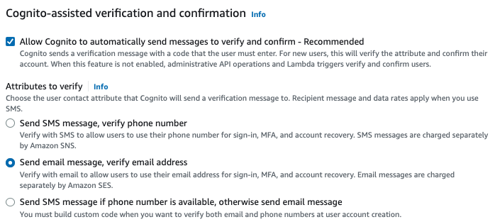
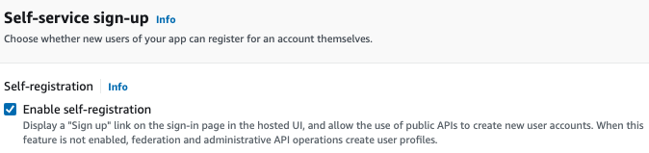
Basic Information - User Pools
A user pool is a user directory that can be configured in a lot of different ways.
It could even allow to login from an Identity Provider
It can, or cannot, be configured with access to an Identity Pool.
By default, users can sign-up.
By default, users just need to verify their email with a code sent to them.
https://t.me/CyberFreeCourses
https://cloud.hacktricks.xyz/pentesting-cloud/aws-pentesting/aws-services/aws-cognito-enum/cognito-user-pools

Slide 6
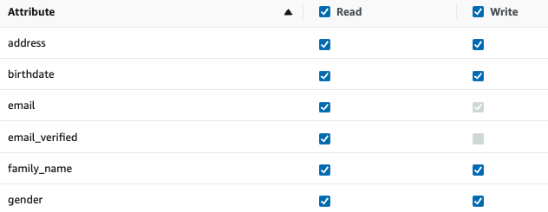
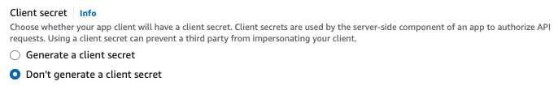
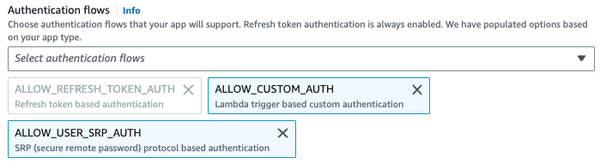
Basic Information - User Pools
By default, secret is not used
By default, users can change the value to (almost) all attributes
By default, users can login (different auth flows)
Groups give access to different IAM roles
https://t.me/CyberFreeCourses
https://cloud.hacktricks.xyz/pentesting-cloud/aws-pentesting/aws-services/aws-cognito-enum/cognito-user-pools

Slide 7
Manual Enumeration
# List Identity Pools
aws cognito-identity list-identity-pools --max-results 60
aws cognito-identity describe-identity-pool --identity-pool-id "eu-west-2:38b294756-2578-8246-9074-5367fc9f5367"
aws cognito-identity list-identities --identity-pool-id "eu-west-2:38b294756-2578-8246-9074-5367fc9f5367" --max-results 60
aws cognito-identity get-identity-pool-roles --identity-pool-id "eu-west-2:38b294756-2578-8246-9074-5367fc9f5367"
# User Pools
## Get pools
aws cognito-idp list-user-pools --max-results 60
## Get users
aws cognito-idp list-users --user-pool-id <user-pool-id>
## Get groups
aws cognito-idp list-groups --user-pool-id <user-pool-id>
## Get users in a group
aws cognito-idp list-users-in-group --user-pool-id <user-pool-id> --group-name <group-name>
## List App IDs of a user pool
aws cognito-idp list-user-pool-clients --user-pool-id <user-pool-id>
## List configured identity providers for a user pool
aws cognito-idp list-identity-providers --user-pool-id <user-poo
## List user import jobs
aws cognito-idp list-user-import-jobs --user-pool-id <user-pool-id> --max-results 60
## Get MFA config of a user pool
aws cognito-idp get-user-pool-mfa-config --user-pool-id <user-pool-id>
## Get risk configuration
aws cognito-idp describe-risk-configuration --user-pool-id <user-pool-id>
https://t.me/CyberFreeCourses
https://cloud.hacktricks.xyz/pentesting-cloud/aws-pentesting/aws-services/aws-cognito-enum

Slide 8
Unauthenticated Access
DEMO
Via unauthenticated Identity Pool IAM Role (with any of the 2 flows)
Via self-registration in User Pool getting access to the website
Via authenticated Identity Pool IAM Role
https://t.me/CyberFreeCourses
https://cloud.hacktricks.xyz/pentesting-cloud/aws-pentesting/aws-unauthenticated-enum-access/aws-cognito-unauthenticated-enum
Notes:
Demo https://ctfincognito.s3.amazonaws.com/index.html

Slide 9
Privilege Escalation
cognito-identity:SetIdentityPoolRoles, iam:PassRole
Grant any Cognito role to the authenticated/unauthenticated users of the Cognito app.
cognito-identity:update-identity-pool
Add a User Pool into an Identity Pool and get IAM roles assigned to it
cognito-idp:AdminCreateUser
Create a new user in a User Pool
cognito-idp:AdminSetUserPassword
Change password of any user
cognito-idp:AdminUpdateUserAttributes
Change the email or phone number or any other attribute of a user.
cognito-idp:CreateIdentityProvider
Create a new identity provider to then be able to login through this provider.
https://t.me/CyberFreeCourses
https://cloud.hacktricks.xyz/pentesting-cloud/aws-pentesting/aws-privilege-escalation/aws-cognito-privesc

Slide 10
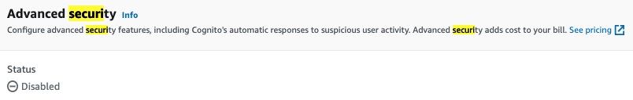
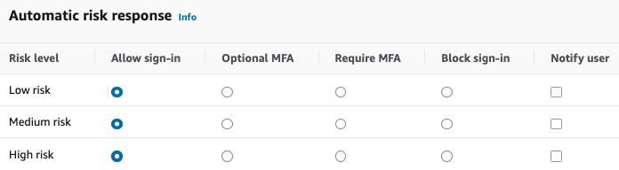
Persistence
cognito-idp:SetRiskConfiguration
Disable automatic actions if risk is detected
https://t.me/CyberFreeCourses
https://cloud.hacktricks.xyz/pentesting-cloud/aws-pentesting/aws-persistence/aws-cognito-persistence

